Slide 1
Practical Training on Web Development
Department of Computer Science & Enginnering
National Institute of Technology, Uttarakhand
Akhilesh Yadav (BT18CSE015)

Slide 2
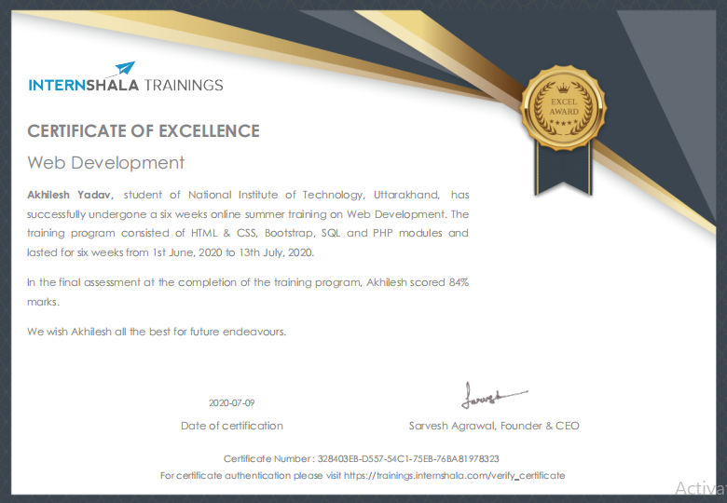

Slide 3
Web Development
Web Development is building & maintainance of website
Involve work behind the scene
to look website great
to make fast
perform well
web dev divided into :
Front-end Dev
Back-end Dev

Slide 4
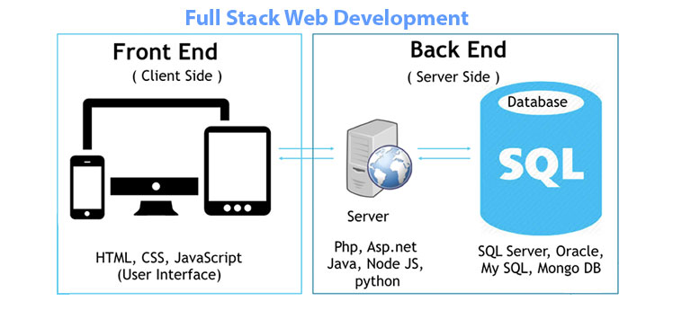
Front-end Vs Back-end Development
Front-end Development
Back-end Development
what user can see
concern about the design
work behind the scene
concern about the working

Slide 5
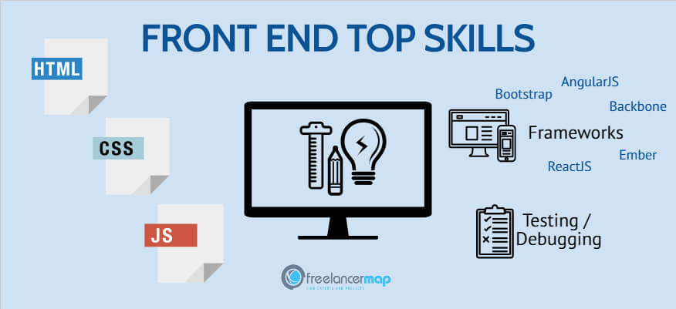
Front-end Development

Slide 6

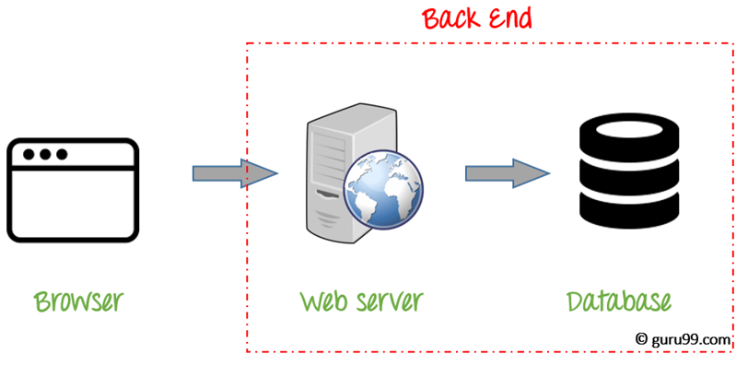


Back-end Development

Slide 7

Design of Front-end
Header
nav-links
Body
division
side-links
images
message
Footer

Slide 8
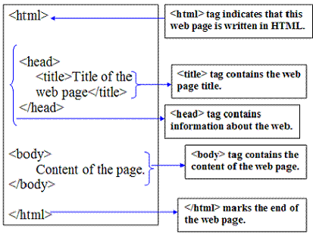
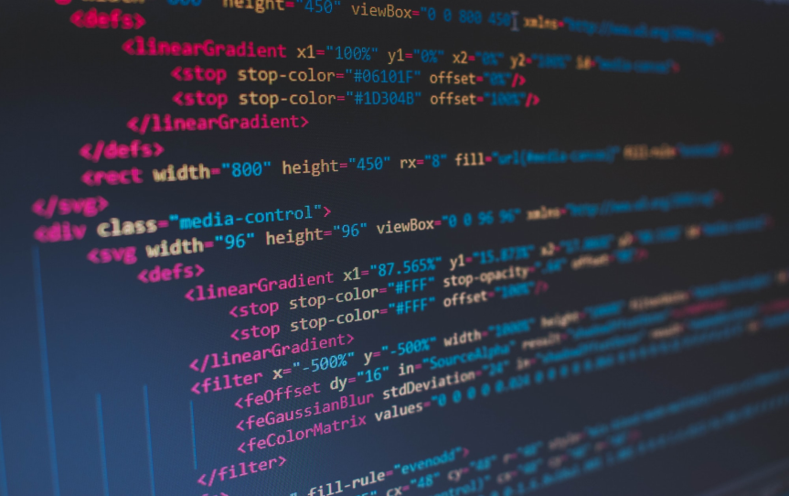
Hyper Text Markup Language (HTML)
HTML is standard markup language
Easy to learn
Tags to design layout

Slide 9
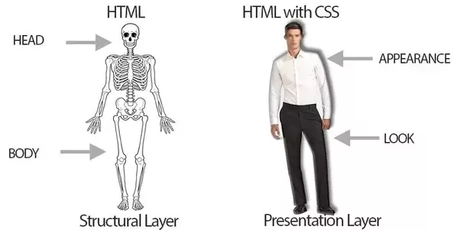
Cascading Style Sheet (CSS)
use to style an HTML document
inline
internal
external
how element get displayed
padding
margin
color
background

Slide 10
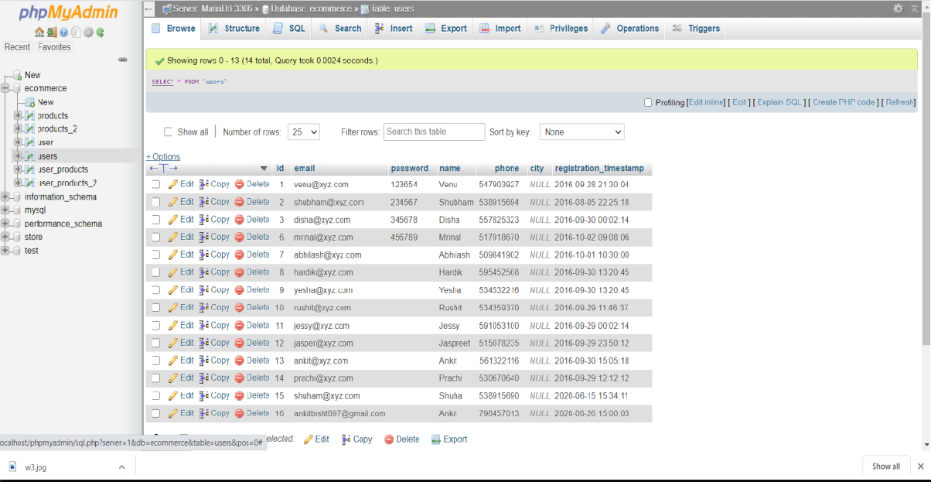
Structured Query Language (SQL)
use for :
storing data
making database
creating tables
manipulating data
insertion
deletion
retrieving data
selection

Slide 11


How to link Database with website
Link Database
LINK
Web Sites
Database

Slide 12
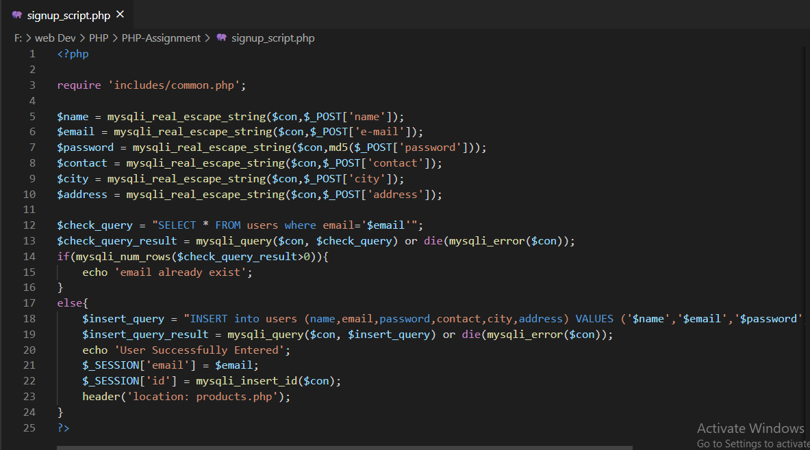
Hypertext Pre-processor (PHP)
It is server side scripting language
use to make dynamic web page
use to store data in database
to save user details
to save login session details
use to fetch data for
authentication purpose
to display content on website

Slide 13

Home Page

Slide 14
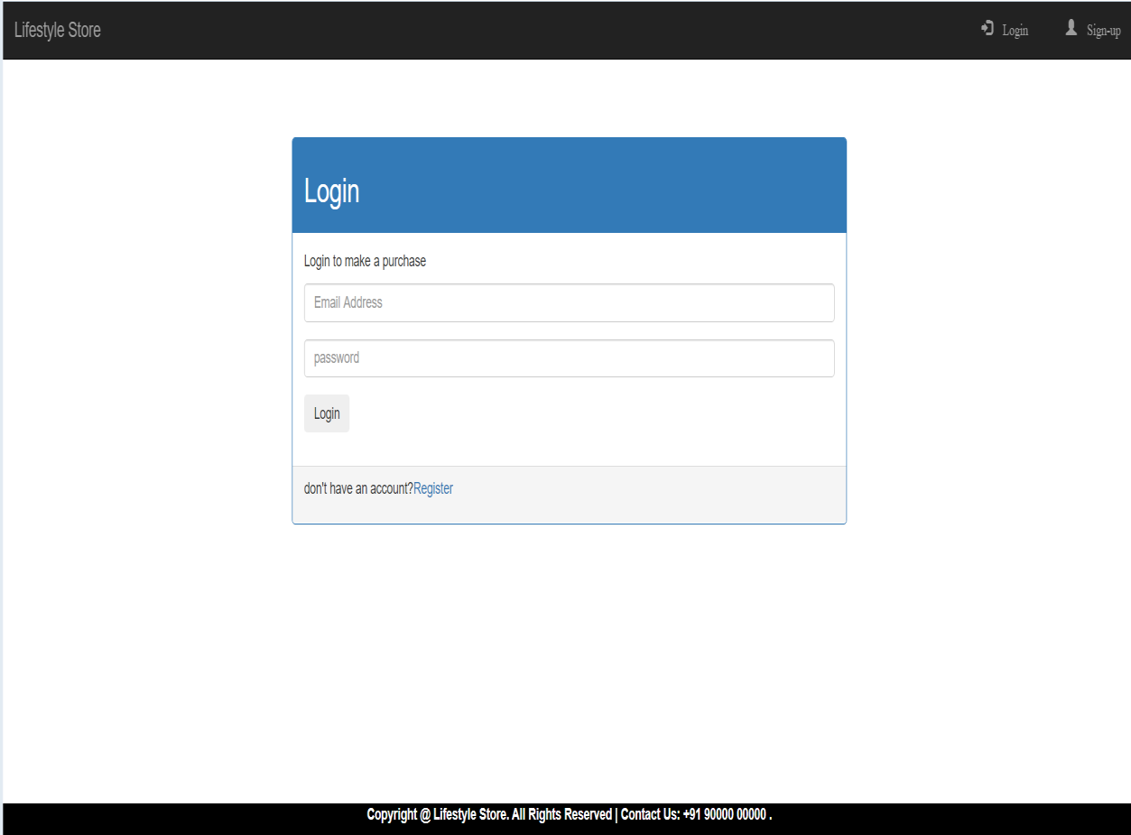
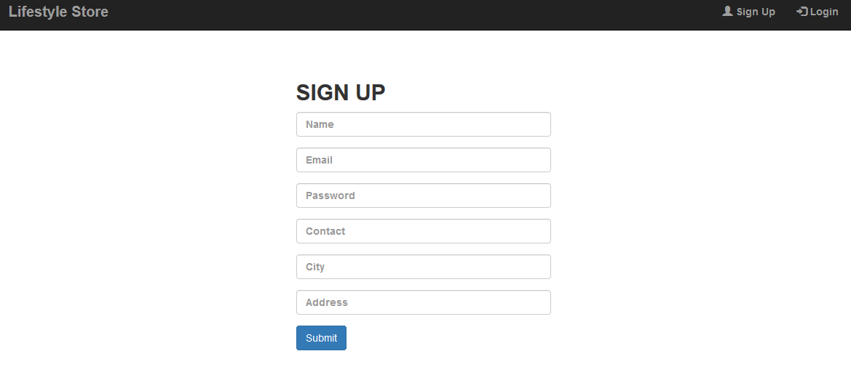
Login & Signup Page

Slide 15
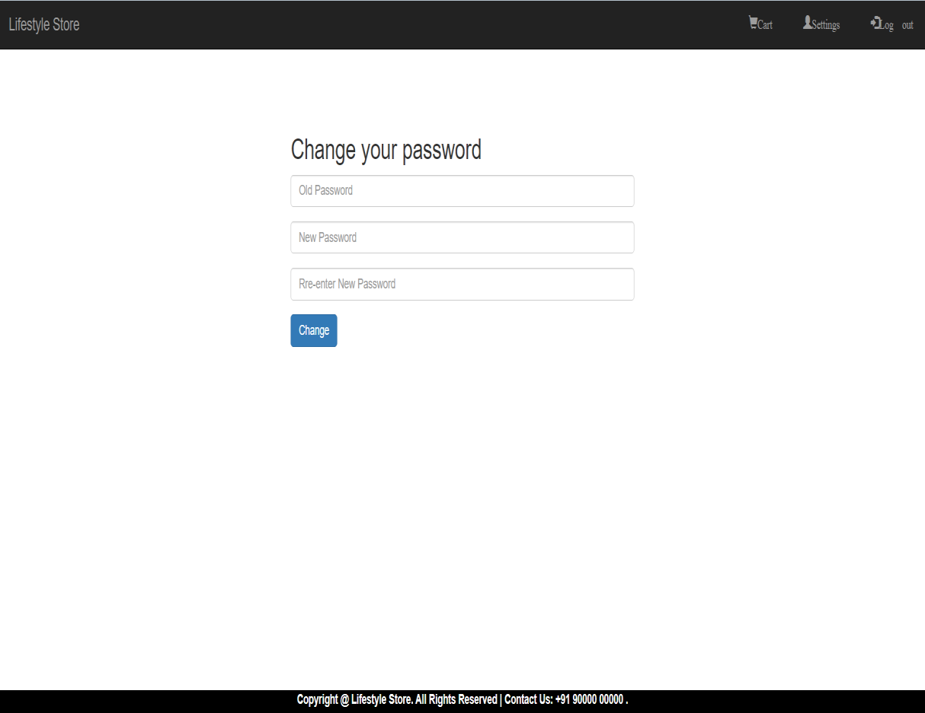

Settings and Cart Page

Slide 16




Slide 17
THANK YOU
Akhilesh Yadav
BT18CSE015

